Slide 1
Status of INSPIRE implementation in EU Member States.
INSPIRE conference – Lisbon, 26/05/2015
Paul Hasenohr, European Environment Agency

Slide 2
Outlook
A few words about Monitoring and Reporting
The implementation status of INSPIRE seen through the Monitoring indicators over the past three years
Ongoing work around Monitoring

Slide 3
A few words about Monitoring and Reporting
Regulatory framework
Legally binding
Article 21 of INSPIRE Directive
Commission Decision of 5 June 2009 implementing Directive 2007/2/EC of the European Parliament and of the Council as regards monitoring and reporting
Guidelines, justification document, templates and supporting tools
New file format used to exchange INSPIRE Monitoring data
New tools to generate the INSPIRE monitoring data:
Manually
Semi-automatically from the metadata contained in the national geoportals

Slide 4
Tools supporting the INSPIRE monitoring
Web tool generating INSPIRE monitoring XML file
Form to register each dataset and service individually
Module to import all data from the XLS files used previously
Developed and financed by EEA
INSPIRE dashboard [https://inspire-dashboard.eea.europa.eu/dashboard]
To generate (part of) the INSPIRE monitoring XML out of the metadata harvested from national discovery services
To visualize the reported monitoring indicators
To visualize up to date monitoring indicators
Conceived by the MIG (MIWP-16), financed by EEA, developed by Titellus

Slide 5
Most deliveries in time this year

Slide 6
Metadata availability and conformity

Slide 7
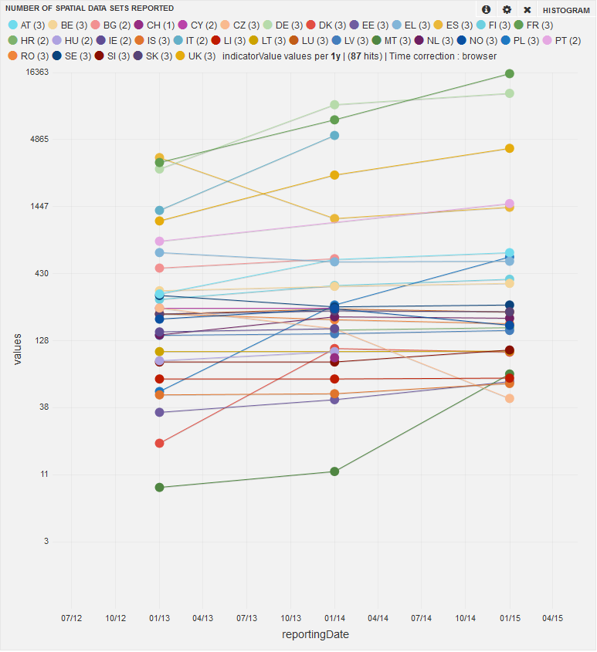
Number of spatial data sets reported

Slide 8
Existence of metadata (data sets and services)

Slide 9
Existence of metadata (Annex I)

Slide 10
Existence of metadata (Annex II)

Slide 11
Existence of metadata (Annex III)

Slide 12
Existence of metadata (spatial data services)

Slide 13
Conformity of metadata (data sets and services)

Slide 14
Conformity of metadata (Annex I)

Slide 15
Conformity of metadata (Annex II)

Slide 16
Conformity of metadata (Annex III)

Slide 17
Conformity of metadata (spatial data services)

Slide 18
Accessibility of metadata through discovery services

Slide 19
Spatial data sets availability and conformity

Slide 20
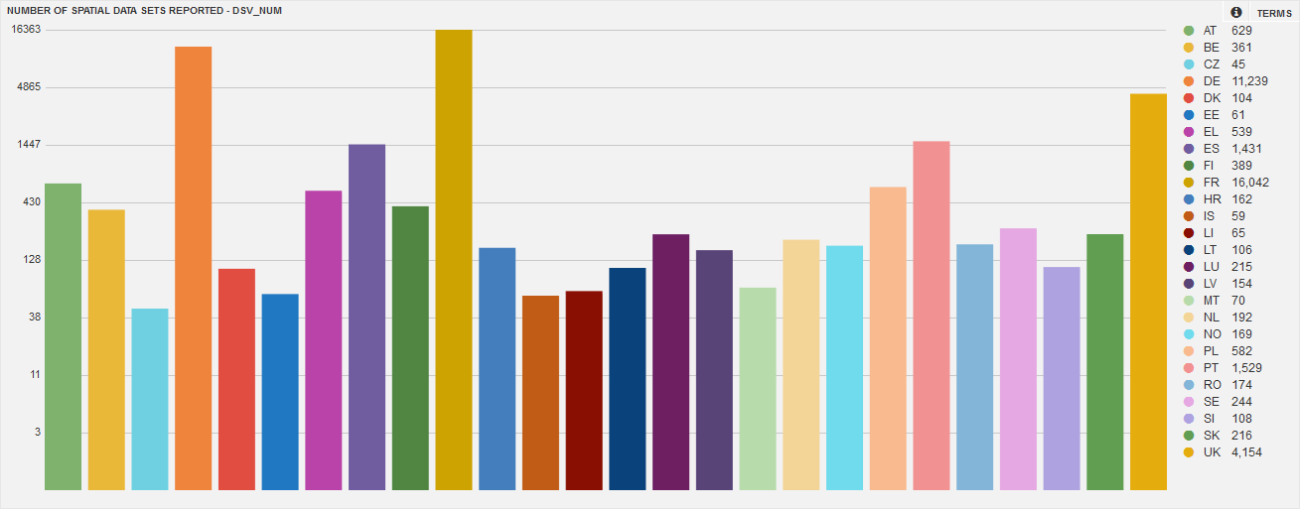
Number of spatial data sets reported

Slide 21
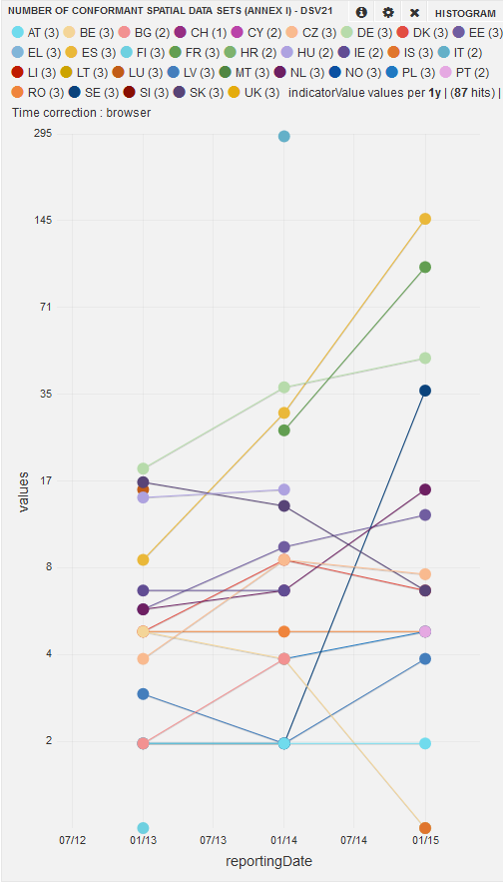
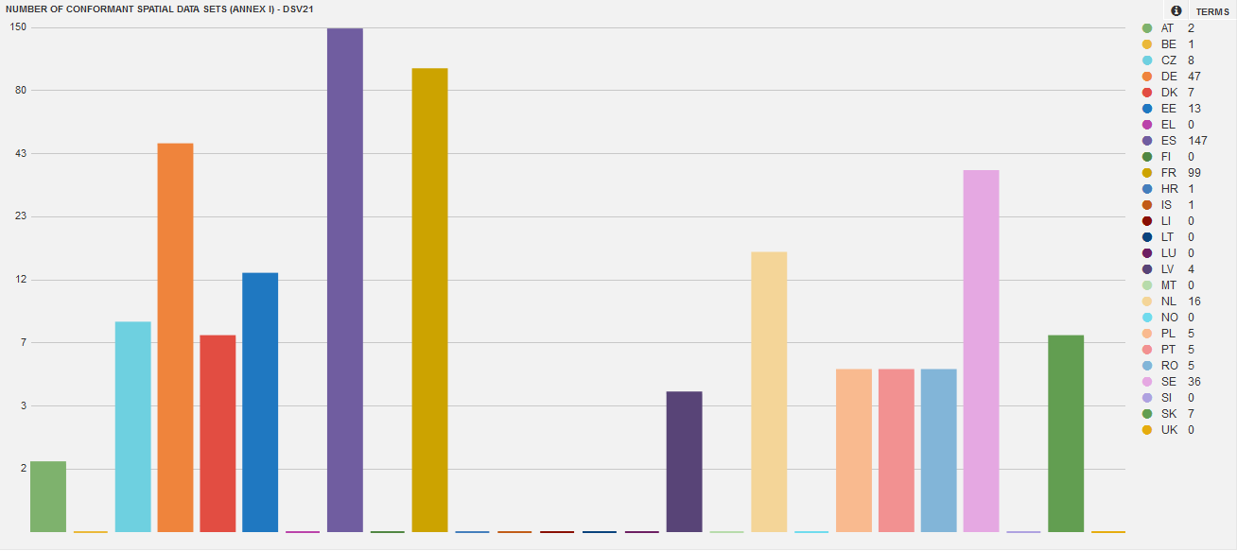
Number of conformant spatial data sets (Annex I)

Slide 22
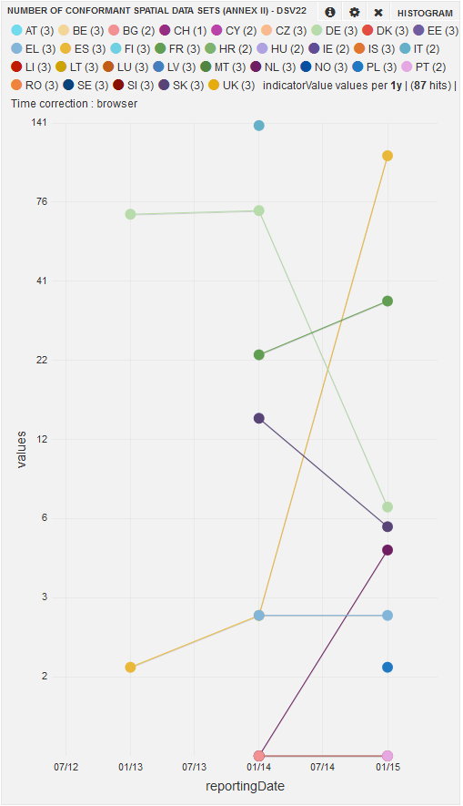
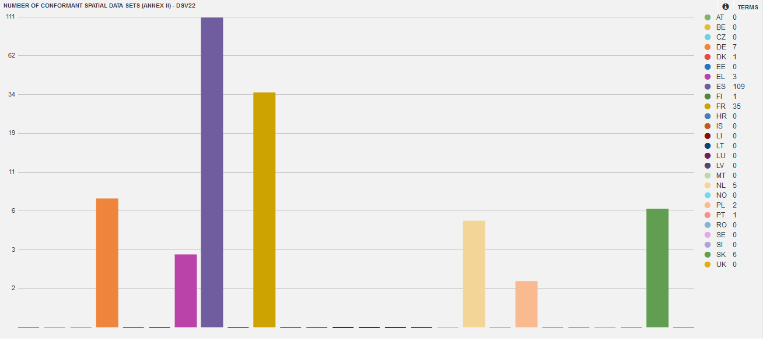
Number of conformant spatial data sets (Annex II)

Slide 23
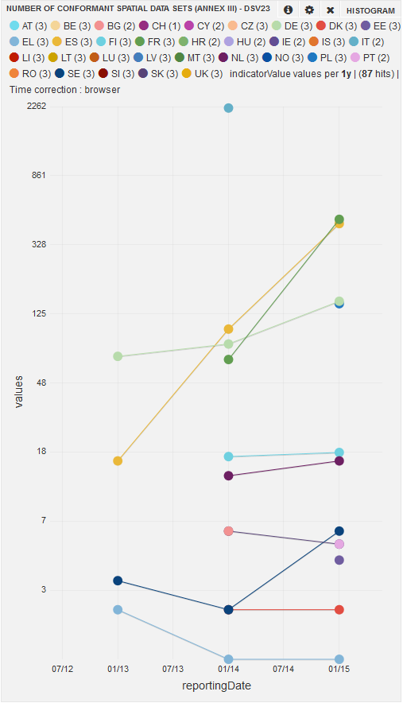
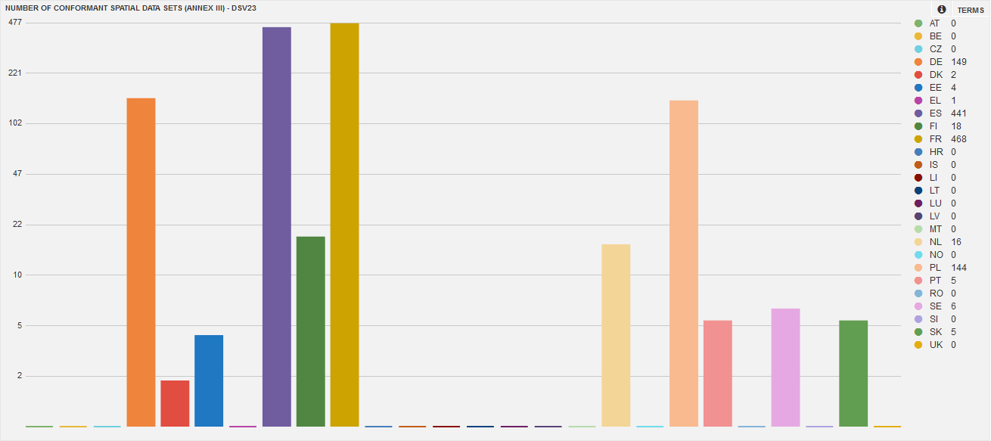
Number of conformant spatial data sets (Annex III)

Slide 24
Conformity of spatial data sets (all annexes)

Slide 25
Conformity of spatial data sets (Annex I)

Slide 26
Conformity of spatial data sets (Annex II)

Slide 27
Conformity of spatial data sets (Annex III)

Slide 28
Accessibility of spatial data sets through view and download services

Slide 29
Accessibility of spatial data sets through view services

Slide 30
Accessibility of spatial data sets through download services

Slide 31
Network services availability and conformity

Slide 32
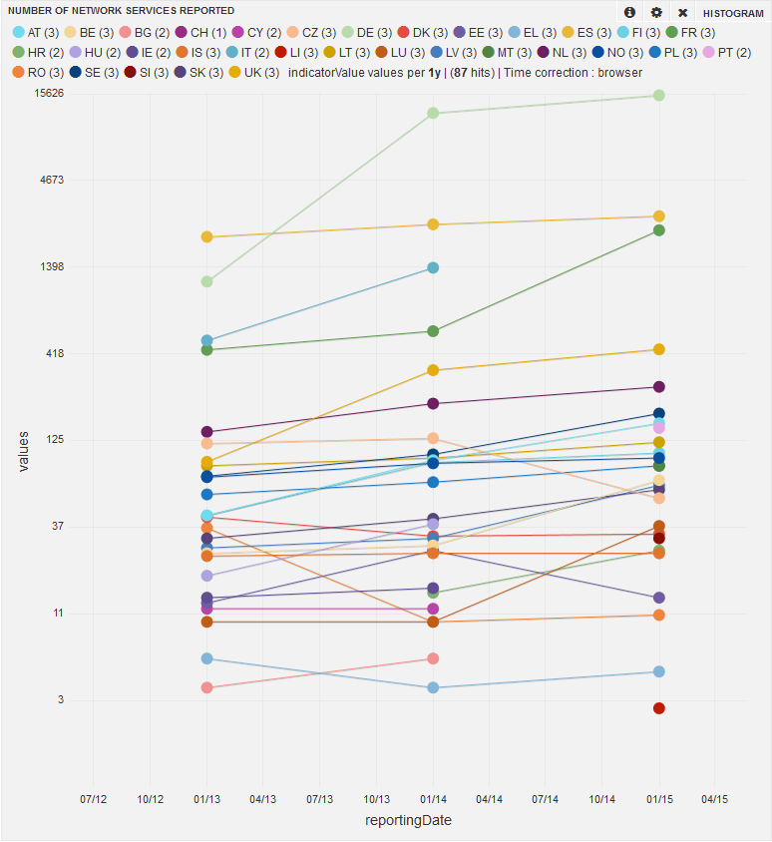
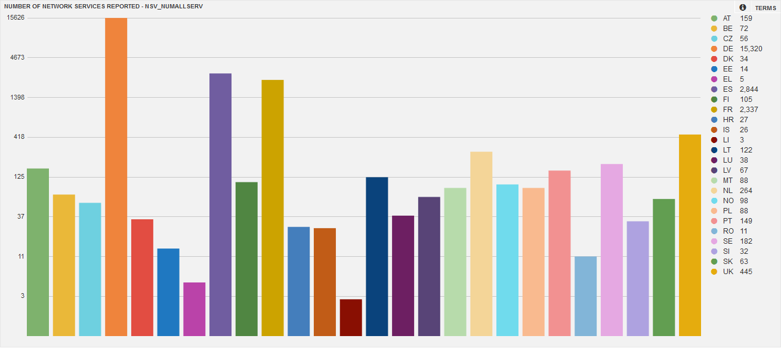
Number of network services reported

Slide 33
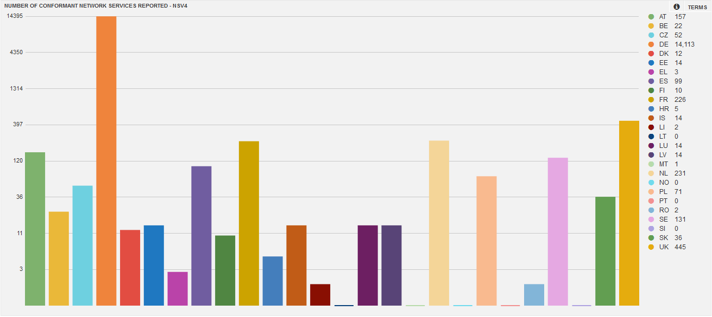
Number of conformant network services

Slide 34
Conformity of discovery network services

Slide 35
Conformity of view network services

Slide 36
Conformity of download network services

Slide 37
Ongoing work around Monitoring
MIG/MIWP-16
Objective: Improve usefulness and reliability of monitoring information
Group active since January 2014
Focus on:
Developing further the dashboard
to better support automated monitoring
to improve the visualisation of the indicators
Reviewing the indicators
Improve the quality of the reported data

