Slide 1
Deltagelse i MIWP

Slide 2
Work Programme 2016-2020: open actions
MIWP-ID | Task
2016.4 | Theme specific issues of data specifications & exchange of implementation experiences in thematic domains
2016.5 | Priority list of data sets for eReporting
2017.1 | Drafting of "Master Guidelines" for the INSPIRE Directive
2017.2 | Alternative encodings for INSPIRE data
2017.3 | Improved client support for INSPIRE data
2017.4 | Validation and conformity testing
2018.1 | Streamlining the monitoring and reporting for 2019 (phase 2)
2019.2 | Improving accessibility of data sets through network services
Notes:
Maintenance and Implementation Work Programme (MIWP) 2016-2020.

Slide 3
GeographicalName
voidable & nilReason
INSPIRE data models are complex
nested structures
multiplicitet
…
GML

Slide 4
2017.2:
1: Begrebsafklaring
2: Modeltransformation
3: Alternative encodings
& additional encodings
fælles datamodel
INSPIRE Generic Conceptual Model
forenklet fælles datamodel
system A
system B
[softwaresystem]
dataoverførsel
”bits & bytes”
struktur: format
indhold: datamodel
[softwaresystem]
Forvalter og lagrer data.
Kan skrive data ned (≈ “encode”) så det følger den fælles datamodel.
Gør noget med data.
Kan forstå (≈ “decode”) data der følger den fælles datamodel.
GML
GeoJSON
…

Slide 5
https://webgate.ec.europa.eu/fpfis/wikis/display/InspireMIG/Action+2017.2+on+alternative+encodings+for+INSPIRE+data

Slide 6
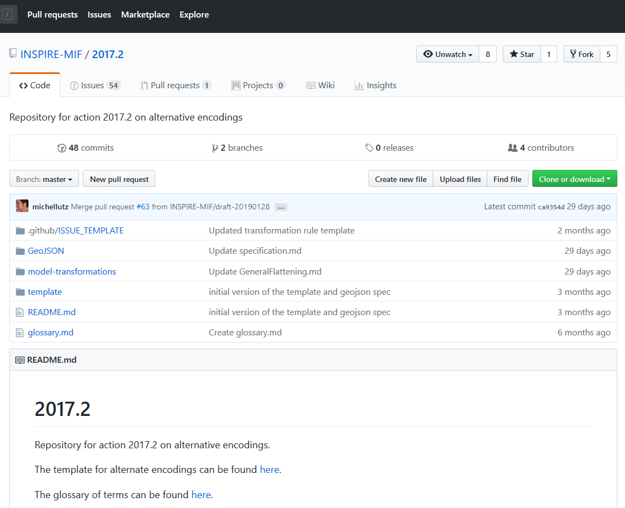
https://github.com/INSPIRE-MIF/2017.2

Slide 7
Work Programme 2016-2020: open actions
MIWP-ID | Task
2016.4 | Theme specific issues of data specifications & exchange of implementation experiences in thematic domains
2016.5 | Priority list of data sets for eReporting
2017.1 | Drafting of "Master Guidelines" for the INSPIRE Directive
2017.2 | Alternative encodings for INSPIRE data
2017.3 | Improved client support for INSPIRE data
2017.4 | Validation and conformity testing
2018.1 | Streamlining the monitoring and reporting for 2019 (phase 2)
2019.2 | Improving accessibility of data sets through network services

Slide 8
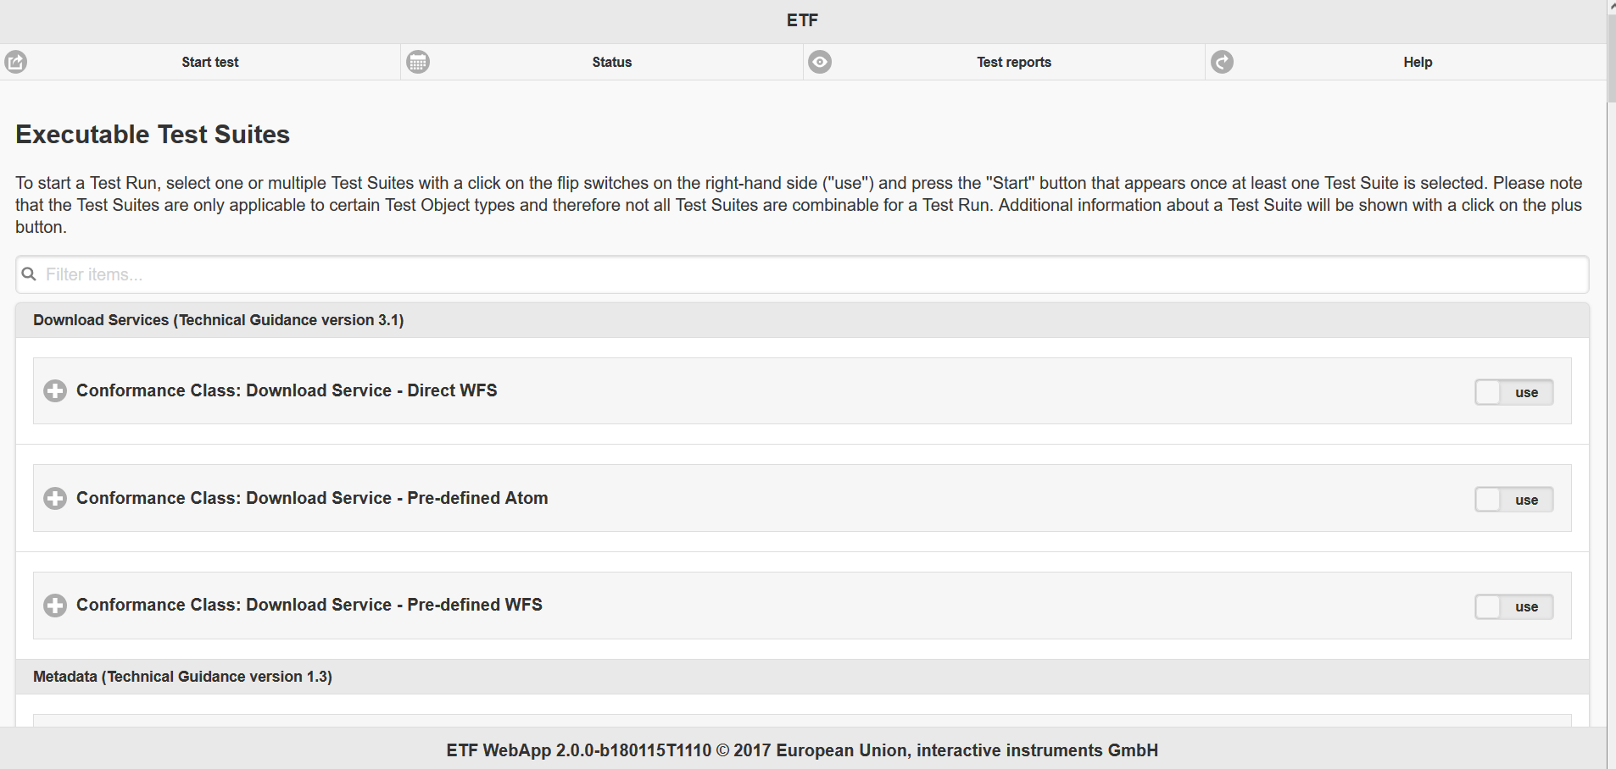
Validator

Slide 9
https://webgate.ec.europa.eu/fpfis/wikis/display/InspireMIG/Action+2017.4+on+validation+and+conformity+testing

Slide 10
